Slide 1
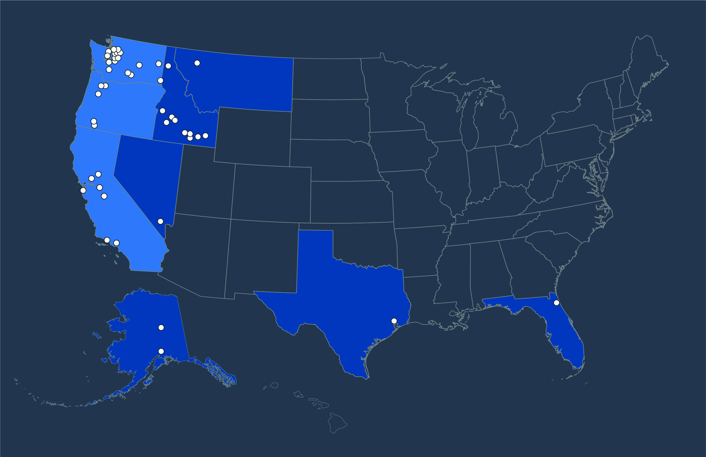
New Partner Orientation
HSC 104
1-3pm

Slide 2

SFCI Video

Slide 3
Getting Started
Forms
MOU
W-9
Volunteer Application
New Partner Worksheet

Slide 4
Coordinator Reference Guide
1. Coordinator Handbook
2. Coordinator Welcome Packet – 1st 90 days
3. Student Enrollment Guide – After Applied
4. Student Orientation Guide – August
5. Academic Coaching Guide – Throughout the Semester

Slide 5

Promotion & Recruitment

Slide 6

Reimagine Recruitment
Share information
Develop relationships
Communicate internship’s vision and ethos
Influence

Slide 7

Recruitment Funnel
Inquiry
Applicant
Admitted
Enrolled

Slide 8
Student Timeline
Preferred
September – December
Consider options
Complete application for admission
January – March
Finalize application material (often transcript)
Submit FAFSA
April – July
Plan for finances
Register for courses
August
Final details
Attend orientation
Fast Track
January – March
Consider options
Complete application for admission
April – May
Finalize application material (often transcript)
Submit FAFSA
June – July
Plan for finances
Register for courses
August
Final details
Attend orientation

Slide 9

Program Cycle
September – January
Plan for year
Update materials
Promote program (include parents)
Recruit and collect inquiries
February – March
Encourage application for admission
and FAFSA
April – July
Finalize application materials
Register for courses
August
Final details
Orientation
Launch!

Slide 10
Communication Plan
Inquiry
Relationship building
Benefits of program
Applicant to NU (communication will come from NU)
Missing items
Apply for financial aid
Admitted (communication will come from NU)
Complete pre-registration
Register for courses
Financial plan in place

Slide 11
Tracking Status
What is the goal?
What is the next step?
Is the student academically qualified?
Is the student financially prepared?

Slide 12
Planning for Transitions
Orientation
First week of courses
First session
First semester

Slide 13
Tips
Identify your internship’s niche
Develop a pitch
What does the student value?
Money talk
Leverage influential voices
Try not to take “no” personally
Celebrate the wins

Slide 14
Setting Up Internship
Submit
1. Intern Application
2. Intern Overview / Weekly Schedule
3. Practicum Syllabus Worksheet
How NU awards credit for your internship
Eagle Page – Templates and Examples

Slide 15
Setting Up Internship
Time | Monday | Tuesday | Wednesday | Thursday | Friday | Saturday | Sunday
6:00 – 7:00
7:00 – 8:00
8:00 – 8:30
8:30 – 9:00
9:00 – 9:30
9:30 – 10:00
10:00 – 10:30
10:30 – 11:00
11:00 – 11:30
11:30 – 12:00
12:00 – 12:30 | Lunch | Lunch | Lunch | Lunch | Lunch | Lunch | Lunch
12:30 – 1:00 | Lunch | Lunch | Lunch | Lunch | Lunch | Lunch | Lunch
1:00 – 1:30
1:30 – 2:00
2:00 – 2:30
2:30 – 3:00
3:00 – 3:30
3:30 – 4:00
4:00 – 4:30
4:30 – 5:00
5:00 – 5:30
5:30 – 6:00
6:00 – 6:30
6:30 – 7:00
7:00 – later
Study Time

Slide 16
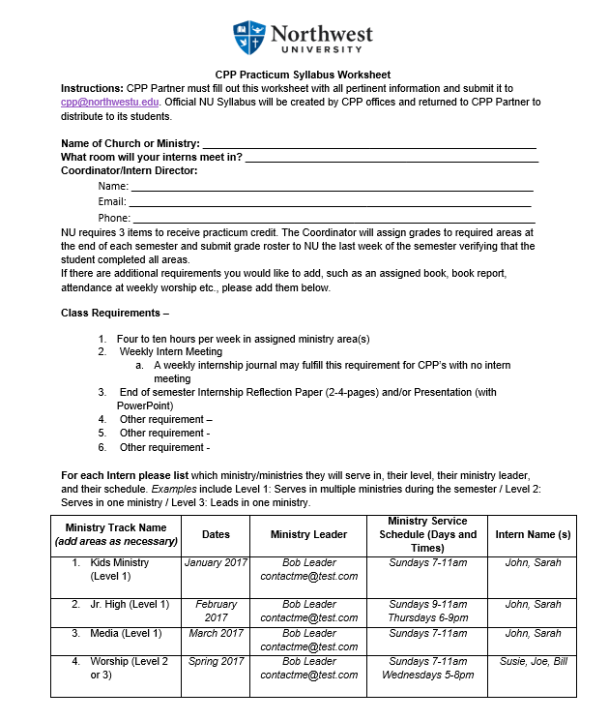

Slide 17
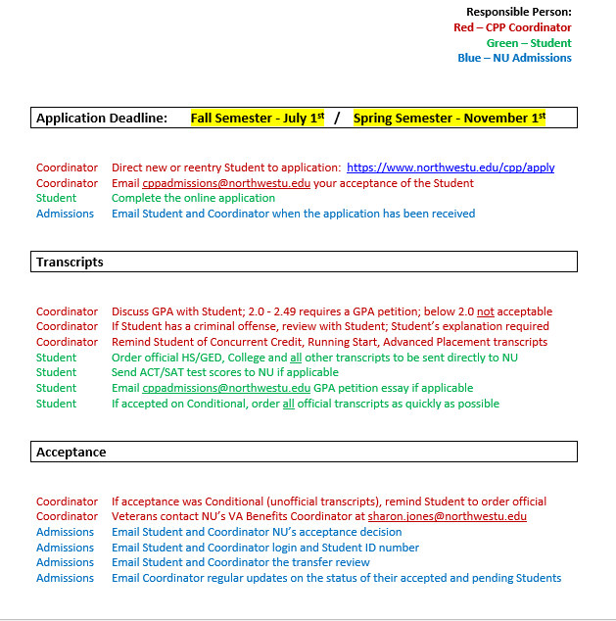
Enrollment Process Overview

Slide 18
Enrollment Process Overview
Definitions
Re-entry Student has not attended NU in the last six months
Acceptance
Regular 2.5 or higher GPA (college and/or high school)
Conditional Unofficial transcripts (enrollment limited to one semester until all officials are received)
Success Strategies 2.0 to 2.49 GPA (see below)
Denied Below 2.0 GPA
Success Strategy - Student must submit a 200-word essay petition explaining why he/she did not do well previously and how and why it will be different this time.
Email petition to cppadmissions@northwestu.edu and copy the Coordinator.
Late Applications considered after deadline if these items are included at the time of application:
Application
Transcripts from all College, High School, AP, Concurrent Credit, Running Start
GPA Petition and Criminal Offense Explanation, if appropriate
FAFSA submitted with NU School Code 003783

Slide 19
Enrollment Process Overview
Contacts
Department Email Type of Question
Admissions cppadmissions@northwestu.edu admission documents and questions
Advising cppadvising@northwestu.edu advising for course selection
Financial Services cppfinancialservices@northwestu.edu financial aid, student accounts
Student Support cppadvising@northwestu.edu student services, add, drop, withdraw
VA Benefits sharon.jones@northwestu.edu coordination of military benefits
Transcripts to:
Northwest University, CPP Admissions,
PO Box 579, Kirkland, WA 98083-0579
Phone - 425.889.7789
Fax - 425.803.3059
Admissions Email: cppadmissions@northwestu.edu
Application Link: https://www.northwestu.edu/cpp/apply

Slide 20
Financial Aid Overview
Federal Application for Federal Student Aid
www.fafsa.ed.gov
Determines eligibility for:
Federal PELL grant
Federal Student Loans (Subsidized and Unsubsidized)

Slide 21
Student Accounts
Account information is available on the Eagle page for the student to view
Statements
Running Balances
1098 T information by February 1
Payments can be made
Account must be Paid In Full each term

Slide 22
Financial Services Contact
CPPFinancialServices@northwestu.edu
Erika Dull, Financial Services Counselor

Slide 23
Academic Coaching Tools
NU Online
Smarthinking – Tutoring & Writing Center
NU Library – Reference & Research Help
Academic Helps Videos
  Study Skill Videos
  Student Time Management Videos
  Writing Help Videos
Grade and Assignment Checks

Slide 24
Academic Coaching Process
May-August – CPP Academic Standards
  2.5 minimum GPA
  2.0 Success Strategy Acceptance
August – Student Orientation
  Weekly Intern Schedule
  First Day of Class Checklist
September – Academic Coaching Center Kickoff
  Academic Planner
  How to use NU Online
  How to use Smarthinking
  How to use NU Library

Slide 25
Academic Coaching Process
Every Session – Grade Check Letters (Weeks 1, 3, 5)
  Drop
  Withdrawal
  Administrative Drop/Withdrawal
  Failing a Class (Consequences)
May – Partner Academic Assessment
  Partner Overall GPA
  Percentage of “Grade Check Letter” Students
  Withdrawal/Failure Percentage

Slide 26
Academic Coaching Tools
NU Online
Smarthinking – Tutoring & Writing Center
NU Library – Reference & Research Help
Academic Helps Videos
  Study Skill Videos
  Student Time Management Videos
  Writing Help Videos
Grade and Assignment Checks

Slide 27
Your Questions for Us

Slide 28
What Now?
3-5pm Optional Drop In Meetings with NU Offices/Free Time
CPP Financial Services |Barton 234
425/889-5325
Registrar | Davis 111
425/889-5228
Accounting (CPP Program Fee) | Davis 205 |
425/889-5233
6-8pm Dinner (Leave time for parking)
Maggiano’s 10455 NE 8th St, Bellevue, WA 98004

