Slide 1

How to Pay for College

Slide 2

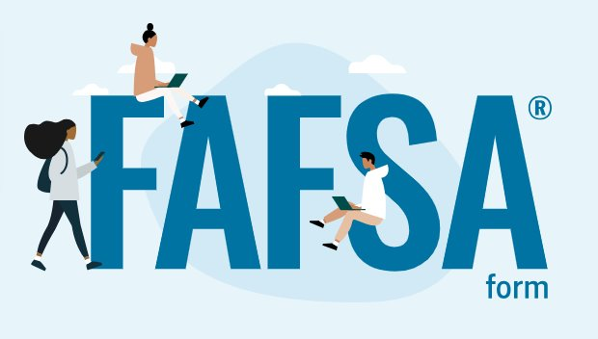
FAFSA Aid – FAFSA.gov
Free Application for Federal Student Aid
School Code: 003783​
FAFSA.gov​
2026-2027 FAFSA is now OPEN!

Slide 3
FAFSA Aid – FAFSA.gov
Free Application for Federal Student Aid
Students must complete a FAFSA to apply for most forms of financial aid.
Students who do not qualify for FAFSA because of their immigration status, may complete a WASFA to apply for Washington State Aid.

Slide 4
Types of Financial Aid
Grants: Gift aid that does not have to be repaid.
Loans: Borrowed money for college which must be repaid with interest
Outside Sources: Scholarships, Private Loans, Employer Benefits, Veteran Benefits, etc.

Slide 5
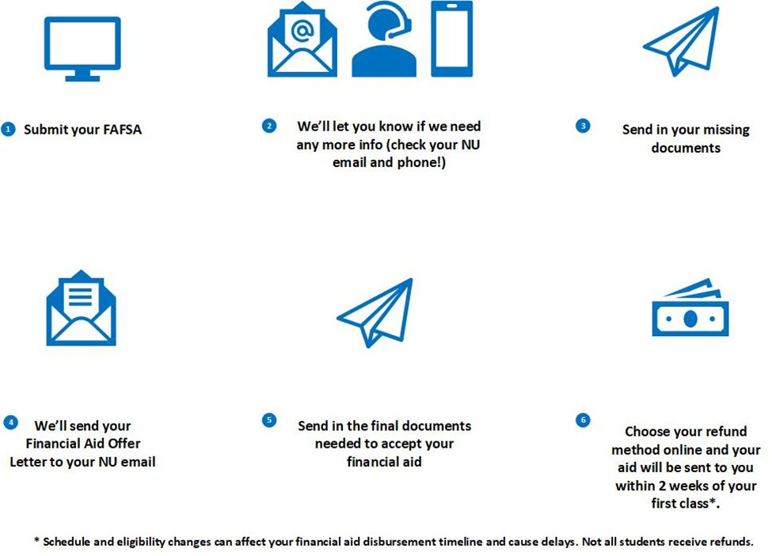
Financial Aid Process
Students must be fully admitted to begin the financial aid process. Missing application pieces, including official transcripts, can delay this process.

Slide 6
Financial Aid Process
Schedule and eligibility changes can affect your financial aid disbursement timeline and cause delays. Not all students receive funds.

Slide 7
Understanding Federal Aid

Slide 8


Federal Aid
Undergraduate Students
Federal Pell Grant is a need-based grant for undergraduate students. ​
Full-time students may receive anywhere from $740 – $7,395 per academic year.

Slide 9
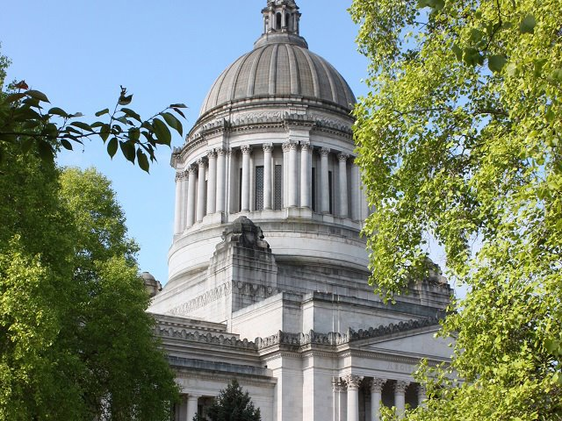
WA State Grants
Undergraduate Students
WA State Grants are need-based grants for eligible undergraduate students, who are WA State residents, and not pursuing or intending to pursue ministry or theology degrees or minors *. ​
Full-time students eligible for WA State aid may receive anywhere from $974 – $18,949 per academic year (dependent upon number of semesters attended and if also eligible for WA College Bound Scholarship.

Slide 10
WA State Grants
Undergraduate Students
​
* Due to state law, Washington State financial aid is not available to students pursuing (or intending to pursue) a major or minor offered by the College of Ministry or receiving credit for the PMIN Practicum course as part of their partnership academic program.

Slide 11

Federal Student Loans
Undergraduate Students
​
Most undergraduates receive up to $5,500- $12,500 depending on their dependency status and grade level.​
This may include a Federal Subsidized and/or Unsubsidized Loan.

Slide 12
Federal Parent PLUS Loans
Undergraduate Students
In addition to federal student loans, the U.S. Department of Education makes federal PLUS Loans available to eligible parents of dependent undergraduate students.
To receive a PLUS Loan, the student must complete a FAFSA and be enrolled at least half-time, and the parent must not have an adverse credit history.​

Slide 13
Federal Parent PLUS Loans
Undergraduate Students
The parent must complete a separate application to apply for a PLUS Loan, during which a credit check will be performed to determine credit-worthiness.
Eligible parents can borrow up to their child’s annual cost of attendance minus any other financial aid they receive. Cost of attendance varies by academic program and number of enrolled credits.

Slide 14
Federal Unsubsidized Loan
Graduate Students
Most graduate students are eligible for up to $20,500 in a federal student loan per academic year.​
This loan is called a Federal Unsubsidized Loan.

Slide 15

Federal PLUS Loan
Graduate Students
In addition to the $20,050 unsubsidized loan, the U.S. Department of Education makes federal PLUS Loans available to eligible graduate students.
To receive a PLUS loan, the graduate student must complete a FAFSA, be enrolled at-least half time, and not have an adverse credit history.
​

Slide 16
Federal PLUS Loan
Graduate Students
A separate application is required to apply for a PLUS Loan, during which a credit check will be performed to determine credit-worthiness.
Eligible graduate students can borrow up to their annual cost of attendance minus any other financial aid they receive. Cost of attendance varies by academic program and number of enrolled credits.
​

Slide 17
Other Forms of Aid
Veteran Benefits – contact veterans@northwestu.edu
Outside Scholarships – Banks, Churches, Tribes, etc.
Employer Benefits – contact studentfinancialservices@northwestu.edu

Slide 18
Paying for College
Finding your costs, payment plans, and understanding deadlines

Slide 19

Paying the Balance
Cost Information can be found online at
Undergraduate & Certificate Programs
www.northwestu.edu/partnership
On-Campus (Hyflex) Graduate Programs
www.northwestu.edu/cost/graduate
Each semester, costs can be determined by following this formula:
Tuition + Fees – Financial Aid
​

Slide 20
Paying the Balance
Deadlines for payment each semester can be viewed online at
www.northwestu.edu/financial-aid/deadlines
Payment Plan options are available through Nelnet each semester.
Payments are generally due the 15th of each month
Students should always ask Student Financial Services for instructions to avoid paying the $75 enrollment fee multiple times.
​

Slide 21
Average Financial Aid Offer
2024-2025 Academic Year
Aid Offered per year
$11,871 (including Washington State Aid for WA residents)
$10,442 (without Washington State Aid)
2024-2025 Cost: $10,592

Slide 22
Other Resources

Slide 23
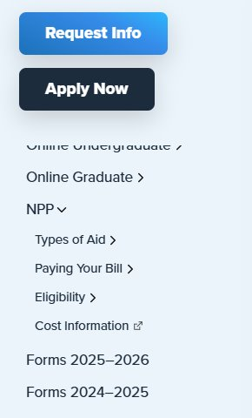
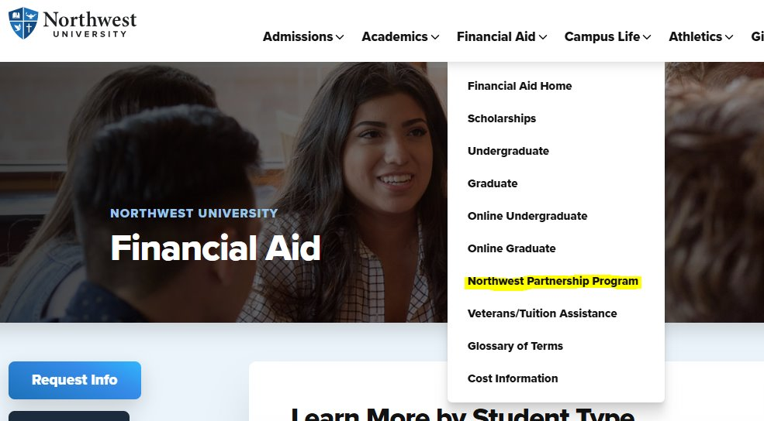
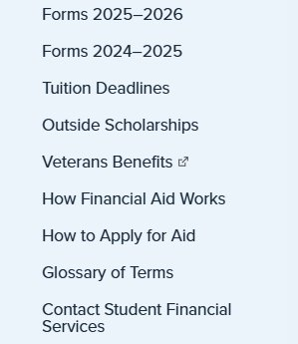
More Information Online
www.northwestu.edu catalog.northwestu.edu

Slide 24
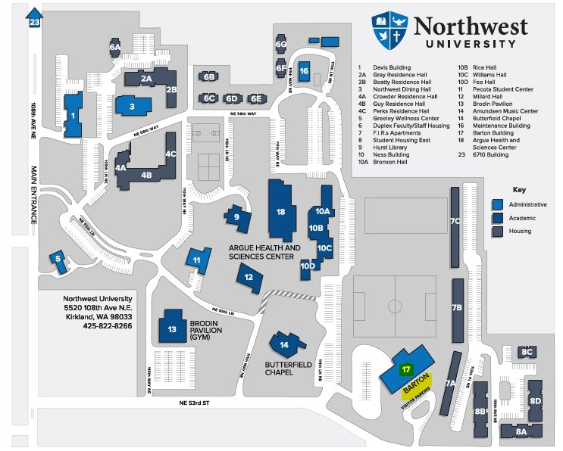
Meet with Us!
On-campus. Barton Room 233
Hours:
M-F 8:30am-4:30pm PST
Mailing Address:
Northwest University
Student Financial Services
PO Box 579
Kirkland, WA 98083

Slide 25
Questions?
nppfinancialservices@northwestu.edu
studentfinancialservices@northwestu.edu

